Slide 1
COE 428 Engineering Algorithms and Data Structures
Dr. Ebrahim Bagheri

Slide 2
Course Information
Ebrahim Bagheri, PhD
Canada Research Chair in Software and Semantic Computing
Associate Professor
My office: ENG 316
Grading policy
Labs and Project 35%
Mid-term Examination 25%
Final Examination 40%

Slide 3
Administrivia
Lecture Hours:
Mondays 10:00-11:00AM (EPH225)
Wednesdays 10-12:00PM (ENGLG05)
Office Hours:
Wednesdays 2:30-3:30PM
ENG316

Slide 4
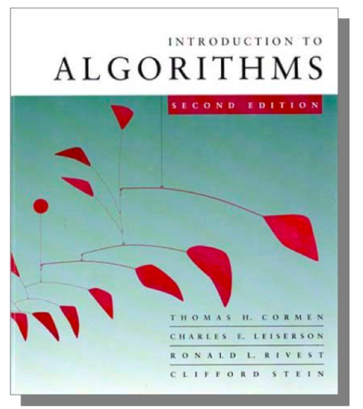
More Information
Textbook
Introduction to Algorithms 2nd ,
Cormen, Leiserson, Rivest and Stein (CLRS),
The MIT Press, 2001.

Slide 5
Administrivia
Lecture notes and slides will be posted to D2L at the end of each week.
All announcements will be made on D2L.
Your responsibility to check D2L for all course related news and information.
Course outline

Slide 6
Lets have a look at D2L BrightSpace

Slide 7
One final note
No cellphones in class
Laptops/tablets only allowed in far end of each row

Slide 8
The Selection Problem
Problem: given a group of n numbers, determine the k^{th} largest
Algorithm 1
Store numbers in an array
Sort the array in descending order
Return the number in position k

Slide 9
The Selection Problem
Algorithm 2
Store first k numbers in an array
Sort the array in descending order
For each remaining number, if the number is larger than the k^{th} number, insert the number in the correct position of the array
Return the number in position k
Which algorithm is better?

Slide 10
Define Problem
Problem:
Description of Input-Output relationship
Algorithm:
A sequence of computational step that transform the input into the output.
Data Structure:
An organized method of storing and retrieving data.
Our task:
Given a problem, design a correct and good algorithm that solves it.

Slide 11
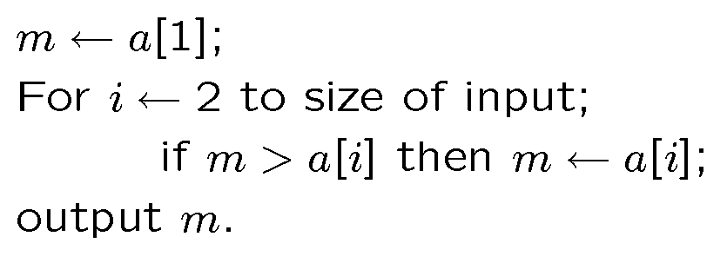
Example Algorithm A
Problem: The input is a sequence of integers stored in array.
Output the minimum.
Algorithm A

Slide 12
Example Algorithm B
This algorithm uses two temporary arrays.
copy the input a to array t1;
assign n ← size of input;
While n > 1
For i ← 1 to n /2
t2[ i ] ← min (t1 [ 2*i ], t1[ 2*i + 1] );
copy array t2 to t1;
n ←n/2;
3. Output t2[1];

Slide 13
Visualize Algorithm B
34
6
5
9
20
8
11
7
Loop 1
6
5
8
7
Loop 2
5
7
Loop 3
5

Slide 14
Example Algorithm C
Sort the input in increasing order. Return the
first element of the sorted data.
34
6
5
9
20
8
11
7
black
box
Sorting
5
6
7
8
9
11
20
34

Slide 15
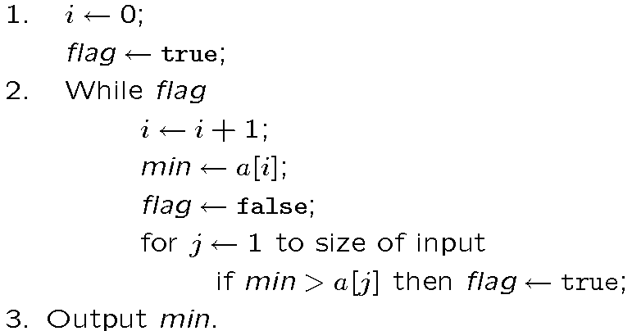
Example Algorithm D
For each element, test whether it is the minimum.

Slide 16
Which algorithm is better?
The algorithms are correct, but which is the best?
Measure the running time (number of operations needed).
Measure the amount of memory used.
Note that the running time of the algorithms increase as the size of the input increases.

Slide 17
Time vs. Size of Input
Measurement parameterized by the size of the input.
The algorithms A,B,C are implemented and run in a PC.
Algorithms D is implemented and run in a supercomputer.
Let T_{k}( n ) be the amount of time taken by the Algorithm
4
T_{d}(n)
T_{c} (n)
Running time
(second)
T_{b} (n)
2
T_{a} (n)
0
500
1000
Input Size

Slide 18
What do we need?
Correctness: Whether the algorithm computes
the correct solution for all instances
Efficiency: Resources needed by the algorithm
1. Time: Number of steps.
2. Space: amount of memory used.
Measurement “model”: Worst case, Average case
and Best case.

Slide 19
RAM model
has one processor
executes one instruction at a time
each instruction takes “unit time”
has fixed-size operands, and
has fixed size storage (RAM and disk).

